Slide 1

Seasonal Agriculture Performance Analysis
Madhavan Reddiar
STU69acf8c06e20d1772943552
SIES College of Arts ,Science and Commerce,
B.Sc Information Technology
VOIS AICTE Batch 1 2026-2027

Slide 2

PROBLEM STATEMENT
Agricultural performance is influenced by seasonal variations in rainfall, temperature, soil conditions, resource use and market conditions.
Raw agricultural data does not clearly explain how performance changes across seasons or what patterns exist.
The problem is to analyze seasonal agricultural data and identify meaningful patterns, trends, relationships and variations in performance across Kharif, Rabi and Zaid seasons.

Slide 3
Project Description
The dataset covers 4000 farm records across 8 Indian states, 8 crops and 3 seasons (Kharif, Rabi, Zaid), capturing environmental conditions, resource usage (fertilizer, pesticide, water, NPK), and economic outcomes (yield, cost, revenue, profit). The project cleans and explores this data to uncover seasonal patterns and relationships, and derive evidence-based recommendations for agricultural planning.

Slide 4

WHO ARE THE END USERS?
Farmers and agricultural cooperatives planning seasonal crop and resource decisions
Government agricultural policy makers and planning departments
Agribusiness and supply chain companies forecasting seasonal output
Researchers and data analysts studying seasonal agricultural trends

Slide 5

Technology Used
Python – Pandas, NumPy for data cleaning and analysis
Matplotlib & Seaborn for data visualization
SciPy for statistical testing (ANOVA)
Google Colab / Jupyter Notebook as the development environment

Slide 6
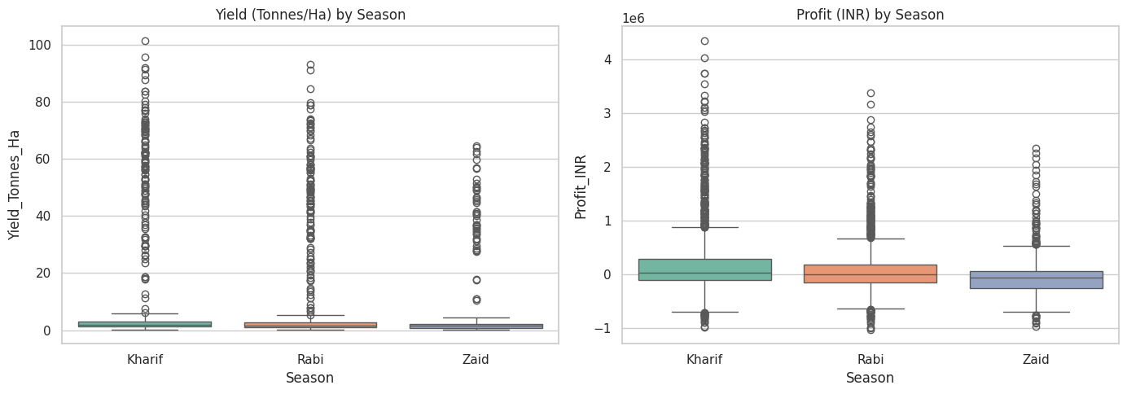
Seasonal Yield & Profit Comparison
Yield and profit both vary meaningfully across Kharif, Rabi and Zaid seasons.

Slide 7
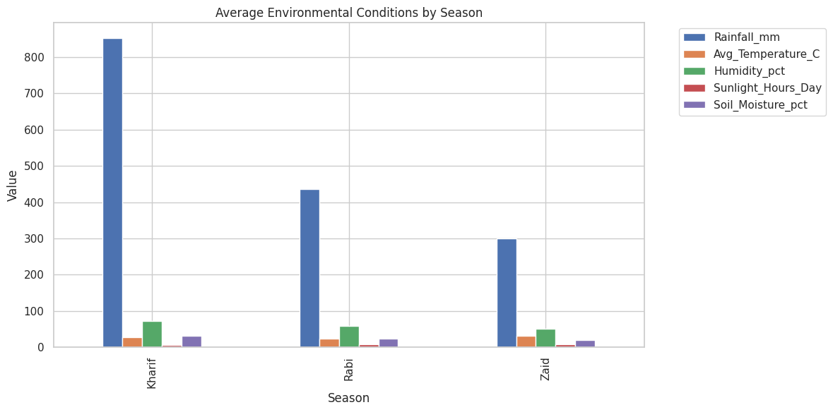
Environmental Conditions by Season
Rainfall, temperature, humidity, sunlight and soil moisture follow distinct seasonal cycles.

Slide 8
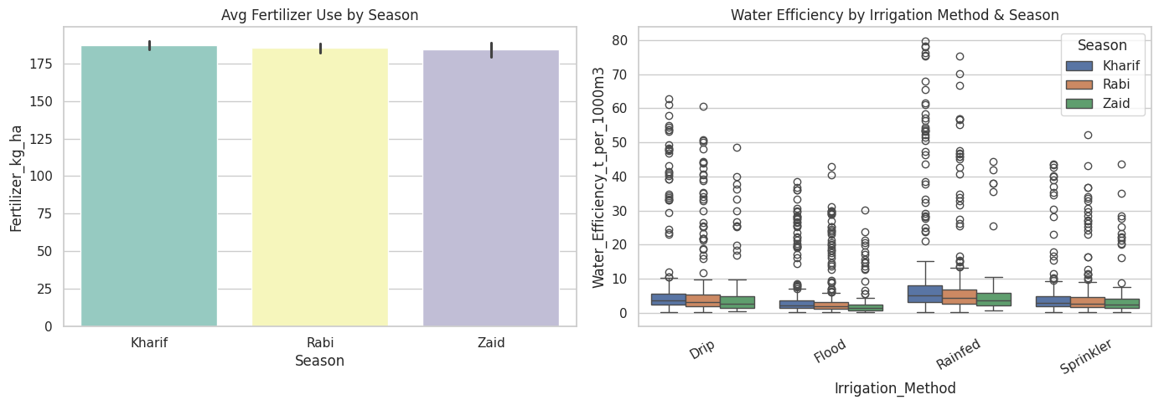
Resource Usage & Water Efficiency
Fertilizer use and water efficiency by irrigation method differ across seasons.

Slide 9
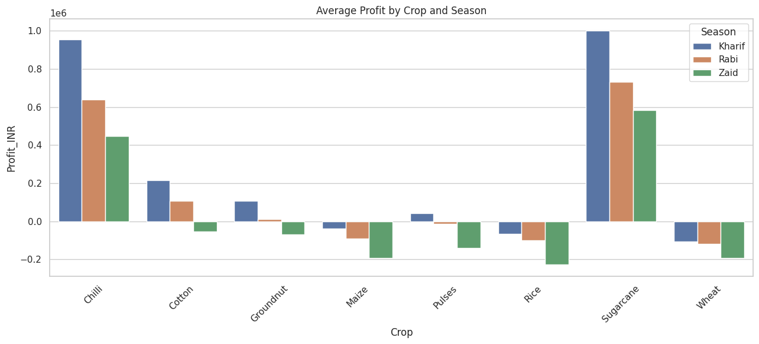
Crop-wise Profit by Season
Profitability of each crop changes depending on the season it is grown in.

Slide 10
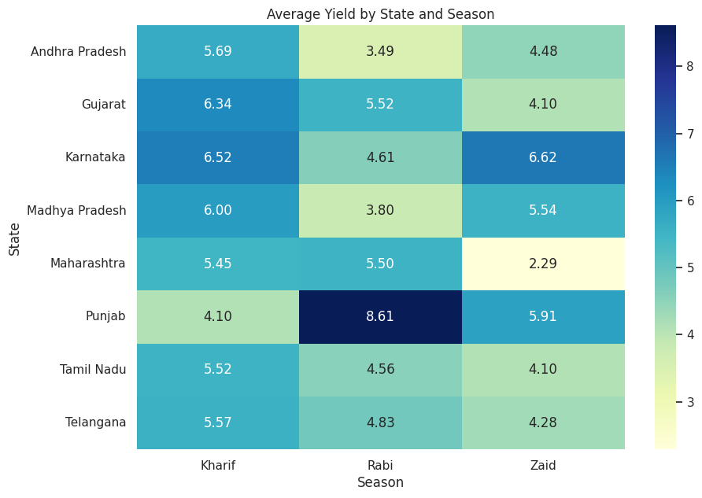
Average Yield by State & Season
Regional yield performance is not uniform – the best season varies by state.

Slide 11
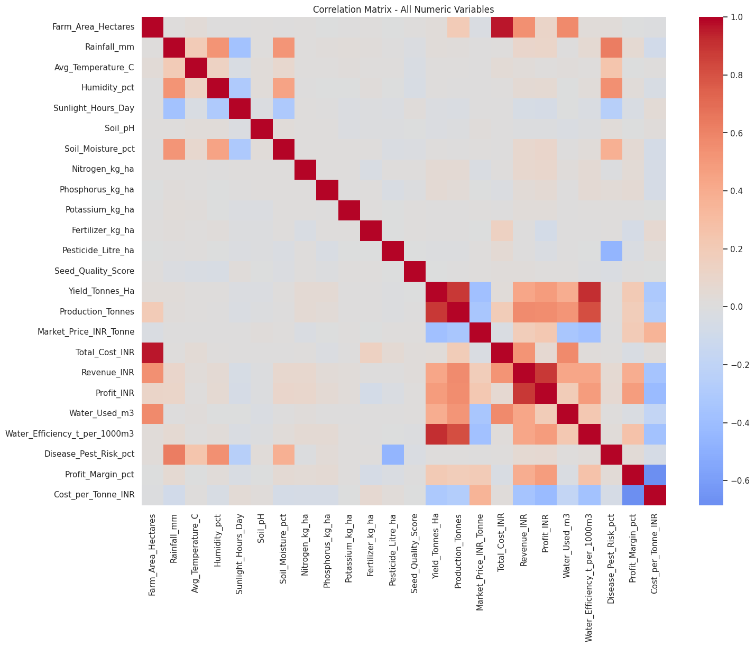
Overall Correlation Analysis
Correlation matrix highlighting which factors most strongly influence yield and profit.

Slide 12
Future scope
Build predictive models to forecast seasonal yield and profit
Integrate real-time weather and market price data
Develop a district-level crop and irrigation recommendation system
Study the long-term impact of climate change on seasonal patterns

Slide 13
GitHub Link
https://github.com/madhavanreddiyar/Seasonal-Agriculture-Performance-Analysis

Slide 14

VOIS Course completion certificate - Course name- Data Visualization

Slide 15
Thank you
.
.

